Slide 1
What The Hack BI 2 AI

Slide 2
What The Hackとは?
課題解決型ハッカソン
3~5人でチームとなり、与えられた 技術課題を解決する
ステップバイステップをなぞるのではなく、チームで解決方法を探し出す
お互いの学び、知識の共有が重要
コーチは答えを出さない、ヒントはあり

Slide 3
What The Hackのコンテンツ
インフラ
K8s 概要
K8s 応用
アプリ
Rock, Paper, Scissors, Boom!
運用/DevOps
Azure Monitoring
Azure DevOps
データ・AI
IaC: ARM & DSC
Front Door
Azure Governance
IaC: Terraform
IaC: Ansible
App Modernization
Microservices In Azure
Serverless
Migrating Applications To The Cloud
Identity For Apps (TBD)
Open Source DevOps
Mastering Linux (TBD)
BI 2 AI
ThisOldDataWarehouse
Databricks/Intro to ML
Intro to Azure AI
Driving Miss Data
https://github.com/microsoft/WhatTheHack

Slide 4
目標
BIやAIを活用したアナリティクス ソリューションを実装する
Azure BlobStorage, SQL Database, PowerBI Desktop, Azure Machine Learningなどの 使い方を学ぶ

Slide 5




データやAIのスペシャリストはAzureデータプラットフォームをフル活用する力がある
Reports & dashboards
Azure Data Factory
Azure Databricks
Azure SQL DW
Azure ML
Datasets
Dataflows
Azure データレイク
CDM folder
CDM folder
CDM folder
データサイエンティスト データエンジニア
コーディングあり
ビジネスアナリスト
コーディング率低

Slide 6
でももし…
Reports & dashboards
…データフローやPower BIの外で生成されたデータを最大限利用したいとしたら？
…もしくは、Power BI内外でデータ分析を、簡単な方法で実現したいなら?
Datasets
Dataflows
Storage

Slide 7

Power BIユーザには 準備万端の可視化サービスがあります
Self service customizations
in Power BI
Dynamics 365 for Finance & Operations
Azure Data Factory
Azure Databricks
Azure SQL DW
Azure ML
Dataflow
Dynamics 365 data
Azure データレイク
CDM folder
Notes:
Challenge: Provide customers with great ready-made insights in the product –and enable unconstrained self service customizations
Dyn365F&O offers best in class ready-made Analytics embedded within the product.
Provide customers with no-cliffs extensibility: Within minutes, Power BI customers should be able to extend solutions leveraging data, reports and dashboards from Dyn365F&O as well as other systems
Extensibility of existing solutions is possible at two levels
Build customization experiences within your application
Enable customization and personalization experiences within the product for users of the App
Data is still contained within the application, not visible to other applications and services
Mashing up with data from other applications and services is not possible
Make data available to applications that specialize in customizations
Leverage the power of rich, robust experiences that Power users and developers are familiar with
Allows integrating data from multiple sources including Web and IoT sensors
Customers may need to copy the data over multiple times or set up ETL infrastructure and storage to make it available
Operations and Finance + Power BI + Dataflows win, because companies can:
Quickly deploy Power BI template with customizable Reports, Dashboards with data in CDM format
Customize or enhance the templates with data from other apps or sources using Power Bi’s rich connectors
Deploy other solutions that depend on schematized data with common or custom data model without any ETL required

Slide 8






Microsoft Cognitive Services
Vision
From faces to feelings, allow your apps to understand images and video
Speech
Hear and speak to your users by filtering noise, identifying speakers, and understanding intent
Language
Process text and learn how to recognize what users want
Knowledge
Map complex information and data in order to solve specific tasks
Search
Access billions of web pages, images, videos, and news with the power of Bing
Labs
An early look at emerging Cognitive Services technologies: discover, try, and give feedback on new technologies before general availability

Slide 9
Microsoft Cognitive Services
Vision
From faces to feelings, allow your apps to understand images and video
Speech
Hear and speak to your users by filtering noise, identifying speakers, and understanding intent
Language
Process text and learn how to recognize what users want
Knowledge
Map complex information and data in order to solve specific tasks
Search
Access billions of web pages, images, videos, and news with the power of Bing
Labs
An early look at emerging Cognitive Services technologies: discover, try, and give feedback on new technologies before general availability

Slide 10
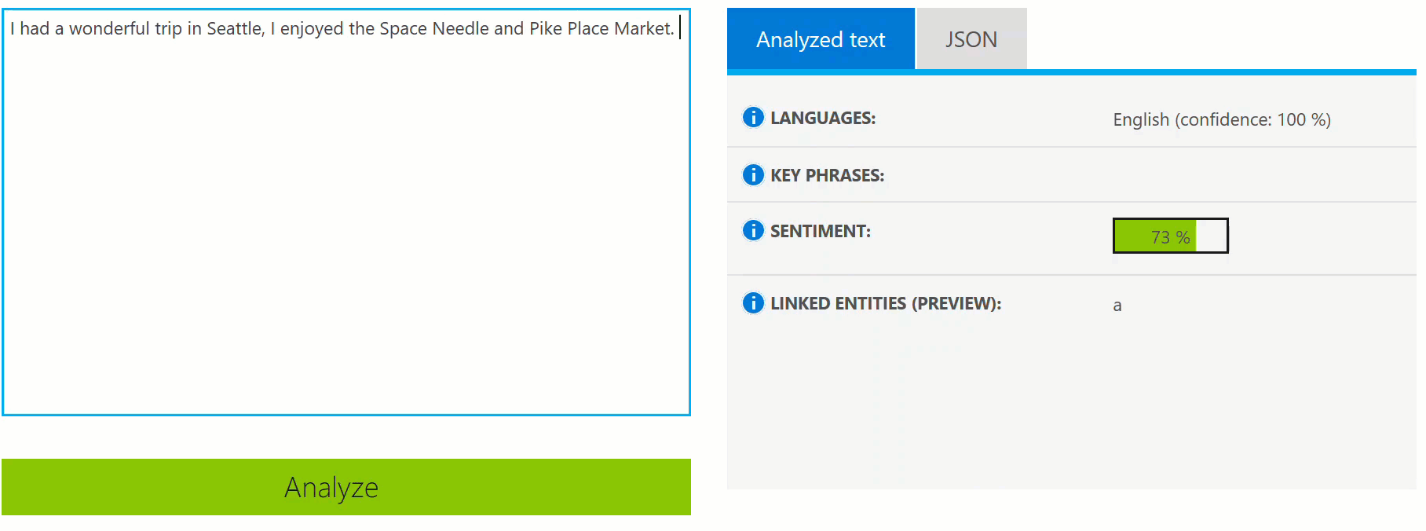
Language
作成したアプリに 自然言語処理の力を。 感情分析やユーザ理解のために。
Notes:
Bing Spell Check API: Microsoft’s state-of-the-art cloud-based spelling algorithms to detect a wide variety of spelling errors and provide accurate suggestions. Using Bing Spell Check, your mobile and PC apps will be powered with state-of-the-art spelling capabilities. Our service is trained on a massive corpus of data gleaned from billions of web pages. There is no need to train your own models. The speller model is updated regularly and incorporates new terms and brands almost as quickly as they appear on the web. This API is available through Microsoft Cognitive Services for customers with low-volume and high-latency jobs. For high-volume and low-latency we have an internal API which may be more suitable. Contact donaldbr directly for more information.
Use cases: 1) Improve the quality of a website's product search 2) provide spell correction for a keyboard app 3) provide spell correction for text fields in an app or web page 4) detect errors in UI text and user data. See https://blogs.msdn.microsoft.com/msr_er/2010/12/15/building-a-better-speller-bing-and-microsoft-research-offer-prizes-for-best-search-engine-spelling-alteration-services/ The speller is exceptional at common spelling errors with low edit-distance (such as febuary->February) but a lot of other spellers are good at that as well. We Do a very good job with word breaking, proper names in context (try "director stephen spielberg") and fictional character names, just a few examples. Areas that are a challenge are capitalization (we don't know what to do with "March" for example, even with context) and consistency (there are times when we will flag a word only intermittently based on the context).
Language Understanding Intelligent Service (LUIS) allows developers to build a model that understands natural language and commands tailored to their application. Example: You can say “turn down the thermostat in the living room,” send it to a LUIS model, and instead of just returning the text that represents what was said, LUIS will return: the action is “turn down,” the location is “living room,” and the target is “thermostat.” LUIS allows developers to iteratively build on these models and take speech or text input and return a structured representation of what the person said. Not only that but by build LUIS will help developers create and train smart conversational bot (Intercom or Slack) with a single button. LUIS will also offer action fulfillment capabilities by simple integration with webhooks. LUIS works pretty well it comes to intents. For the entities, the learning curve is slower especially when the number of entities increases. LUIS only supports 20 intents & 10 entities yet by build each entities can have up to 10 children.
Translator API: Translate speech and text
Language Detection Automatically detect the language of any text string.
Translation Add speech translation, for any of the 9 supported languages, and text translation, for any of the 60 supported languages, to your app.
Text to speech (TTS) Send text strings and receive back the audio version in one of the 19 supported languages.
Custom translation system Build a custom translation system, using as little as 1,000 parallel sentences or start out simply by providing a dictionary of company specific words.
Collaborative translation network Improve translations by creating a specific user group that provides suggestions to improve the translations.
Text Analytics API: The Text Analytics API is a cloud-based service that provides advanced natural language processing over raw text, and includes four main functions: sentiment analysis, key phrase extraction, language detection, and entity linking.

Slide 11
Language
Text Analytics
Bing Spell Check
感情分析、言語検出、 キーフレーズ検出
スペルチェック
Translator Text
Language Understanding
スピーチ to テキスト機能
ユーザからの指示を理解
Notes:
Bing Spell Check API: Microsoft’s state-of-the-art cloud-based spelling algorithms to detect a wide variety of spelling errors and provide accurate suggestions. Using Bing Spell Check, your mobile and PC apps will be powered with state-of-the-art spelling capabilities. Our service is trained on a massive corpus of data gleaned from billions of web pages. There is no need to train your own models. The speller model is updated regularly and incorporates new terms and brands almost as quickly as they appear on the web. This API is available through Microsoft Cognitive Services for customers with low-volume and high-latency jobs. For high-volume and low-latency we have an internal API which may be more suitable. Contact donaldbr directly for more information.
Use cases: 1) Improve the quality of a website's product search 2) provide spell correction for a keyboard app 3) provide spell correction for text fields in an app or web page 4) detect errors in UI text and user data. See https://blogs.msdn.microsoft.com/msr_er/2010/12/15/building-a-better-speller-bing-and-microsoft-research-offer-prizes-for-best-search-engine-spelling-alteration-services/ The speller is exceptional at common spelling errors with low edit-distance (such as febuary->February) but a lot of other spellers are good at that as well. We Do a very good job with word breaking, proper names in context (try "director stephen spielberg") and fictional character names, just a few examples. Areas that are a challenge are capitalization (we don't know what to do with "March" for example, even with context) and consistency (there are times when we will flag a word only intermittently based on the context).
Language Understanding Intelligent Service (LUIS) allows developers to build a model that understands natural language and commands tailored to their application. Example: You can say “turn down the thermostat in the living room,” send it to a LUIS model, and instead of just returning the text that represents what was said, LUIS will return: the action is “turn down,” the location is “living room,” and the target is “thermostat.” LUIS allows developers to iteratively build on these models and take speech or text input and return a structured representation of what the person said. Not only that but by build LUIS will help developers create and train smart conversational bot (Intercom or Slack) with a single button. LUIS will also offer action fulfillment capabilities by simple integration with webhooks. LUIS works pretty well it comes to intents. For the entities, the learning curve is slower especially when the number of entities increases. LUIS only supports 20 intents & 10 entities yet by build each entities can have up to 10 children.
Translator API: Translate speech and text
Language Detection Automatically detect the language of any text string.
Translation Add speech translation, for any of the 9 supported languages, and text translation, for any of the 60 supported languages, to your app.
Text to speech (TTS) Send text strings and receive back the audio version in one of the 19 supported languages.
Custom translation system Build a custom translation system, using as little as 1,000 parallel sentences or start out simply by providing a dictionary of company specific words.
Collaborative translation network Improve translations by creating a specific user group that provides suggestions to improve the translations.
Text Analytics API: The Text Analytics API is a cloud-based service that provides advanced natural language processing over raw text, and includes four main functions: sentiment analysis, key phrase extraction, language detection, and entity linking.

Slide 12





Azure Machine Learning components
ゼロコード 予測結果のレポート化機能 Power BI プレミアムにはすでに備わっています
すべてのスキルレベルに
Notebooks
Automated ML UX
Designer
構造データ
Apps
Models: AKS
Batch predictions: SQL DB
MLOPs
再現性
自動化
デプロイ
再学習
パワフルな計算能力
非構造データ
自然言語、画像など
Analytics
Azure Arc
CPU, GPU, FPGAs
IoT Edge

Slide 13
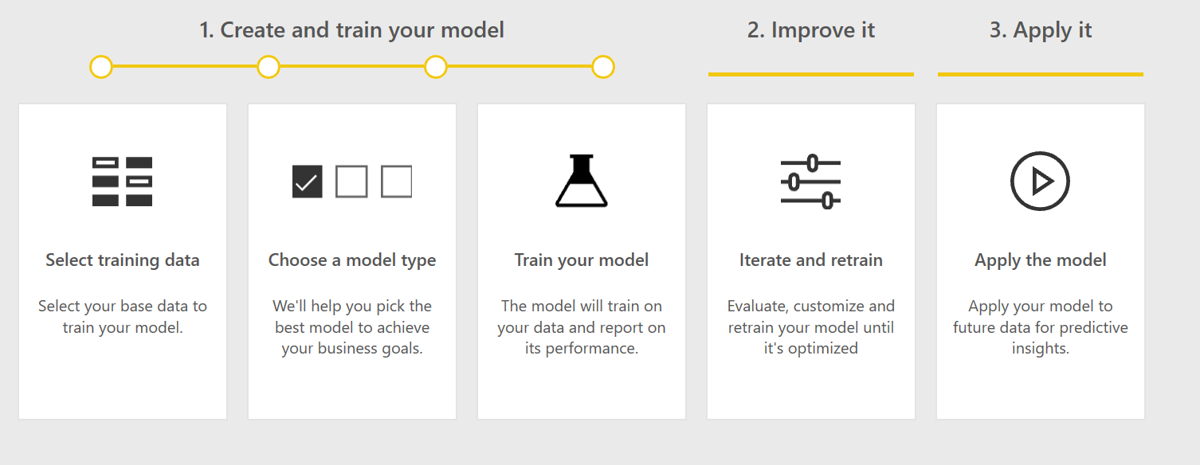
AutoML process

Slide 14
What The Hack BI 2 AI

Slide 15
使用するAzureサービス
Azure Blob Storage
Azure SQL Database
Power BI Desktop, Embedded Capacity, etc.
Azure Machine Learning

Slide 16
STEP 1 – セットアップ
課題
ストレージアカウントを作成
コンテナを作成
必要ファイルをダウンロード & .bacpacをアップロード
https://minhaskamal.github.io/DownGit/#/home?url=https://github.com/chmitch/WhatTheHack/tree/master/018-BI2AI/Coach/Downloads
SQL server (logical)を作成
Firewallについて、Azure servicesからのアクセスを許可するをYesに
Client IPを追加をクリック
AdventureWorksをインポート
Power BI embedded・ワークスペースを作成
終了要件
Azure SQL ServerにAdventureWorks DBを作成
PowerBIにCapacityを指定の上ワークスペースを作成

Slide 17
STEP 2 – Power BIでデータ可視化
課題
データフローを作成
エンティティを追加 (Azure SQL DB)
Customers, Products, DimDate, FactInternetSalesを追加・リネーム
Power BI DesktopにPower BI データフローを追加
データを取得から
左のカラムからデータの関係性を選択
DateKey(Order Dates)とDuteDateKey(Sales)の関係を削除
DateKeyとOrderDateをアクティブに
可視化
フィールドから対象のデータをドラッグアンドドロップ
スライサー、円チャート、線グラフなどで可視化
終了要件
可視化に必要なエンティティを含むデータフローを作成
Power BIモデルを作成
プロダクト別、エリア別の売り上げを任意の年ごとにフィルタリングして可視化

Slide 18
STEP 3 – Cognitive Servicesを利用
課題
エンティティを追加
Bike Reviewsデータをインポート (text/scv)
https://raw.githubusercontent.com/microsoft/WhatTheHack/master/018-BI2AI/Coach/Downloads/bike%20reviews.csv
AIステップを追加 (AIインサイト)
レビューから言語を検出
言語と言語IOSコードを取得
レビューと言語ISOコードからセンチメント(感情)スコアリング
レビューと言語ISOコードからキーフレーズを抽出
セーブして、リフレッシュ
Power BI Desktopでバイクレビューエンティティをインポートして、可視化
終了要件
csvファイルから、レビューデータをデータフローにインポート
言語、感情、キーフレーズを抽出するためにCognitive Servicesを実装
言語別のレビュー数、低い評価を受けるBike、.5未満の評価のレビューに含まれるキーフレーズを可視化

Slide 19
STEP 4 – ML in Power BI
課題
BikeBuyerTrainingとProspectiveBuyerエンティティを追加
ML modelをデータフローに追加
BikeBuyerTrainingをデータソース、BikeBuyersをターゲットカラムとして選択
1をターゲット値として指定 (True)
全てのカラムをトレーニング対象として選択し、時間を5分で指定
Run
レポートを確認
影響の大きいパラメータなど
ProspectiveBuyersにモデルを適用
カラムを追加>Whole number(Fiscal year(duration))
インプットをProspectiveBuyersで指定
終了要件
顧客データでバイク購入予測モデルを作成し、将来の購入可能性をスコアリング
Power BIでどのような顧客がバイクを買う傾向がありそうかを可視化
モデルのパフォーマンスレポートを確認

Slide 20
STEP 5 – Azure ML AutoMLでモデリング
課題
Azure ML ワークスペースを作成
ML Studioへアクセス
https://ml.azure.com/selectWorkspace?tid=common
データセットを作成
SQL Serverと接続
BikeBuyerTrainingを選択
AutoML Serviceを作成
Best Modelをエンドポイント(No Auth)に発行
Power BIで可視化
終了要件
発行したBikeBuyerモデルエンドポイントがAzure ML上でホストされる
API化
上のAPIを利用して、Power BI上にデータフローを追加

Slide 21
まとめ
BIやAIを活用したアナリティクス ソリューションを実装する
Azure BlobStorage, SQL Database, PowerBI Desktop, Azure Machine Learningなどの 使い方を学んだ

Slide 22
参考文献
https://docs.microsoft.com/en-us/cli/azure/sql/db?view=azure-cli-latest#az-sql-db-create
https://docs.microsoft.com/en-us/cli/azure/sql/db?view=azure-cli-latest#az-sql-db-import
https://docs.microsoft.com/en-us/cli/azure/sql/server?view=azure-cli-latest#az-sql-server-create
https://docs.microsoft.com/en-us/cli/azure/sql/server/firewall-rule?view=azure-cli-latest#az-sql-server-firewall-rule-create
https://docs.microsoft.com/en-us/power-bi/service-create-the-new-workspaces
https://docs.microsoft.com/en-us/power-bi/developer/azure-pbie-create-capacity
https://docs.microsoft.com/en-us/power-bi/service-admin-premium-manage
https://docs.microsoft.com/en-us/power-bi/service-dataflows-overview
https://docs.microsoft.com/en-us/power-bi/service-dataflows-create-use
https://docs.microsoft.com/en-us/power-bi/service-cognitive-services
https://docs.microsoft.com/en-us/power-bi/service-tutorial-build-machine-learning-model
https://docs.microsoft.com/en-us/power-bi/service-machine-learning-automated
https://docs.microsoft.com/en-us/power-bi/service-tutorial-build-machine-learning-model
https://radacad.com/age-calculation-in-power-bi-using-power-query
https://docs.microsoft.com/en-us/azure/machine-learning/how-to-create-portal-experiments
https://docs.microsoft.com/en-us/power-bi/service-machine-learning-integration

Slide 23
What The Hack BI 2 AI

Slide 24
Tips (For Hosts)
今回のハックは、SQL serverなどのリソースのプロビジョンニングをCLIではなく、portal上から行うと、ノーコードで実装できるものになっています。逆に言えば、それだけGUI操作や画面遷移などが多いため、ホスト側の負担は増える可能性は高いです。
また、ハンズオンの対象者は、必ずしも開発者やサイエンティストじゃなくてもよさそうです。ビジネスアナリストのロールなどでも、そのハッカソンの効果は表れるかと思います。
とりわけ、データサイエンスにも機械学習にも、AIにも精通している必要はないです。しかしながら、それぞれのコンポーネントがどのようなものを入力として受けつけ、何を出力とするのかを参加者の中でアライメントすることは大切なようにおもいます。
順調にいけば1時間程度で終わりますが、遠隔でハンズオンを実行する際には、遅れを取ってしまう方々も出るかと思いますので、正解のスクリーンキャプチャ動画を随時用意しておくと、参加者にとってはうれしいかもしれません。
ちなみに、各参加者にはハンズオンの後にすぐリソースグループごと削除することを推奨します。Power BI Premiumなどは、5日間ホストするだけで100ドル近くほど課金されてしまうこともあります。

